Slide 1


Welcome Back!
Day 2 – Control Statements in Python
Trainer: Chandramouli Das: Sr Data Scientist
Focus Area: Decision-making and repetition in Python using control flow statements
From Day 1 to Today: We shift from syntax to logic, bringing life to programs
Interactive Coding: Be ready for hands-on sessions, quizzes, and a mini project
Photo by FLASHCOM INDONESIA on Unsplash
Notes:
Welcome back to Python for Data Science! I’m Your Name, your Sr Data Scientist trainer. Today is Day 2 and we’re diving into one of the most impactful aspects of programming: control statements.
From our introduction yesterday, we now move into decision-making tools—`if`, `else`, `elif`, and loops. These are the building blocks that let your programs think, evaluate, and repeat actions intelligently.
This session will be highly interactive with examples, challenges, and a hands-on mini project that ties logic with automation. Let’s begin a deeper dive into Python’s power of control!

Slide 2
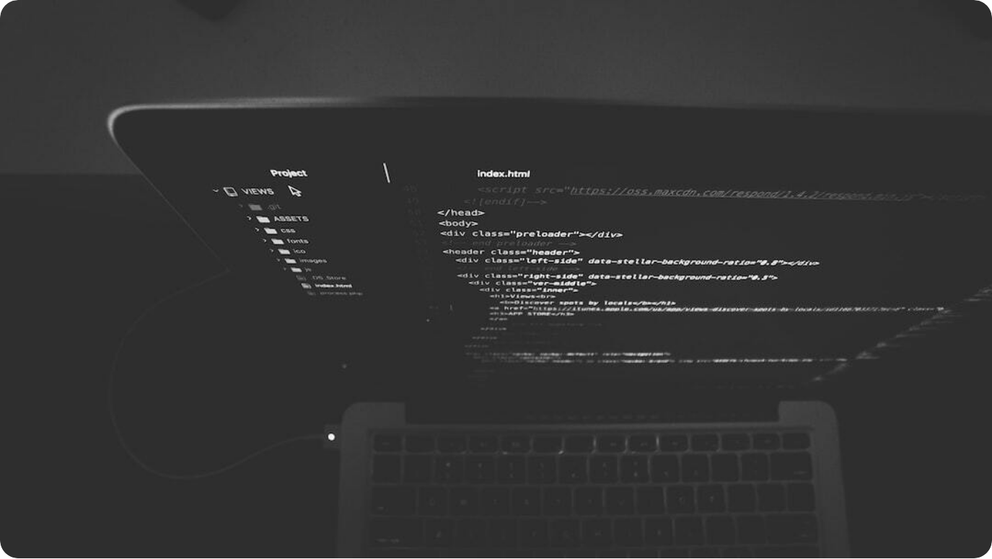
What are Control Statements?
Introduction to Logic Flow in Python
Purpose: Control statements manage the decision-making flow within a program.
Categories: Divided into conditional (if, elif, else) and loop control (for, while, break, continue).
Importance: They enable logic, repetition, and dynamic behavior in code.
Real-World Examples: Used in authentication systems, automation tasks, and decision engines.
Photo by Nate Grant on Unsplash
Notes:
Control statements are the heart of logic in any programming language. They determine how your program reacts to different inputs and conditions. In Python, control statements guide the flow of execution by enabling decisions and repetitions.
These include conditional statements like `if`, `elif`, and `else`, and loop-related structures like `for`, `while`, and modifiers such as `break` and `continue`. Without these tools, your code is static and linear.
Whether it’s processing user input, validating credentials, or building automated workflows, control statements form the backbone of interactive applications. Let’s explore how to harness this power.

Slide 3




The 'if' Statement in Depth
Executing Code Based on Conditions
Basic Syntax
if condition: executes a block only when the condition is True.
Boolean Evaluation
Conditions must return True or False. Use comparison or logical expressions.
Indentation Rule
Indented block defines the controlled scope of 'if'.
Example
if age > 18: print("Eligible to vote")
Notes:
The `if` statement is Python’s primary tool for decision-making. It evaluates a condition, and if that condition is true, it executes the indented block of code beneath it.
For instance, in the condition `if age > 18`, Python checks if the age is greater than 18. If it is, the block of code (like `print("Eligible to vote")`) will run. If not, Python skips it. Remember, indentation is not optional in Python—it's mandatory and denotes the code block being controlled.
This ability to selectively execute code is the first step toward making your programs intelligent. We'll build on this to add more logic layers in the coming slides.

Slide 4

elif and else Clauses
Handling Multiple and Default Conditions
elif Keyword: Allows testing multiple conditions in sequence.
else Block: Captures all other cases when conditions are False.
Use Case: Ideal for scenarios with mutually exclusive outcomes.
Example: if x > 0: ... elif x == 0: ... else: ...
Photo by Amanda Jones on Unsplash
Notes:
The `elif` and `else` clauses build on the basic `if` statement by introducing flexibility and completeness in decision-making. `elif`, which stands for "else if," lets you check multiple conditions one by one. Python executes the first true condition it finds.
The `else` clause is the default block—it runs when none of the preceding conditions are true. This ensures that your program always has a response, even if none of the specific conditions match.
Here's a simple pattern: `if x > 0`, do something; `elif x == 0`, do something else; `else`, handle the rest. This structure makes your code predictable and robust.

Slide 5
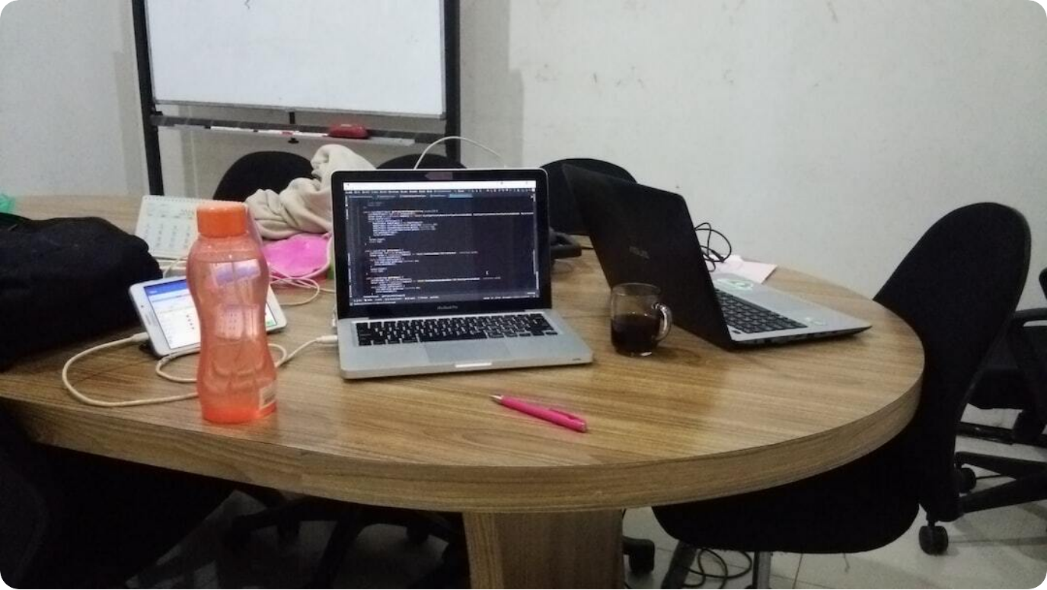
Practical Scenarios: if-elif-else
Logic Flow in Real Applications
Age-based Classification: Check age groups to assign categories (child, adult, senior).
Login Verification: Check username, then password, then lock status.
Traffic Light Control: Assign actions for red, yellow, and green signals.
Weather Advice: Use conditions to suggest actions (raincoat, sunscreen, etc.).
Photo by ar java on Unsplash
Notes:
To bring `if-elif-else` to life, let’s explore common real-world scenarios. One example is age-based classification—if a person’s age is less than 18, they’re a minor; between 18 and 60, an adult; above 60, a senior. This clear branching logic is a perfect use case.
Similarly, login systems use conditions to check username validity, password correctness, and whether an account is locked. Traffic systems use branching to decide what action to take depending on the signal color.
Another example is weather-based suggestions: based on temperature and forecast, you can tell the user whether to carry an umbrella or wear sunscreen. These real-world applications show how foundational control statements are.

Slide 6




Nested Conditionals
Multi-Level Decision Structures
Structure
An if-else block inside another conditional block.
Use Case
Used when decisions depend on a sequence of conditions.
Syntax Sensitivity
Requires strict indentation alignment for clarity and function.
Complexity Warning
Avoid deeply nested logic—refactor using functions when needed.
Notes:
Nested conditionals allow deeper logic in your program. Think of scenarios where one decision leads to another—if a user is logged in, then check their subscription status, and if active, grant access.
This chain of logic relies on nesting `if` statements within others. Python supports this but requires careful indentation to keep the structure readable. Misaligned blocks not only break the program but also confuse collaborators.
As a best practice, avoid excessive nesting by refactoring blocks into functions or using logical operators. Balance flexibility with maintainability when using nested logic.

Slide 7

Common Mistakes in Conditionals
Avoiding Bugs in if-elif-else Logic
Missing Indentation: Incorrect indentation leads to logic errors and crashes.
Unreachable Code: Else after return or break in if makes subsequent code redundant.
Misordered Checks: Place the most likely conditions first for performance.
Incorrect Conditions: Confusing == with = or misusing logical operators.
Photo by SOULSANA on Unsplash
Notes:
Even experienced developers make errors in conditionals. One of the most common is incorrect indentation. Python’s reliance on indentation to define blocks makes it crucial to align code properly.
Another issue is unreachable code—like placing an `else` clause after a return or break statement that ends the function. Also, ordering matters: put the most likely conditions at the top for clarity and efficiency.
A subtle but dangerous mistake is using `=` instead of `==` in conditions. The first is assignment, not comparison! Logical errors also come from combining conditions poorly. Always test your branches and edge cases thoroughly.

Slide 8
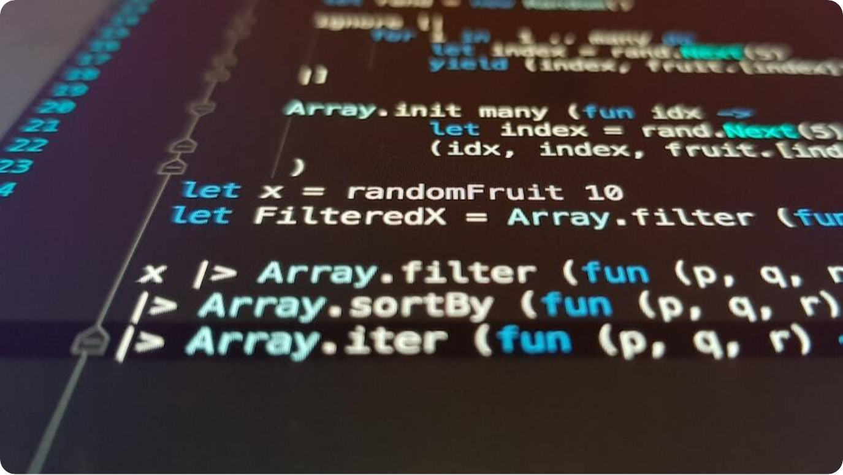
Mini Quiz: Predict the Output
Control Logic Practice Challenge
Conditional Puzzle: What will be the output of this nested if-else code?
Code Block: x = 10 if x > 5: if x < 15: print("A") else: print("B") else: print("C")
Answer Choices: A) A B) B C) C D) Error
Correct Answer: A — both conditions are satisfied.
Photo by Ilija Boshkov on Unsplash
Notes:
Time to put your understanding to the test. Consider this small snippet:
```python
x = 10
if x > 5:
if x < 15:
print("A")
else:
print("B")
else:
print("C")
```
What will this print? Walk through each condition logically. `x` is 10, which is greater than 5 and less than 15. Both conditions are true, so the inner block prints 'A'.
Quizzes like these reinforce how control flows through your code and highlight the importance of indentation and logic structure.

Slide 9
Introduction to Loops
Automating Repetition in Python
For Loop: Iterates over sequences like lists, strings, and ranges.
While Loop: Executes as long as a condition remains true.
Control Flow: Loops enable automation, iteration, and data processing.
Efficiency: Loops reduce code duplication and improve readability.
Photo by Nate Grant on Unsplash
Notes:
Loops are essential for automation in programming. They let your code perform actions repeatedly without needing to duplicate lines. Python supports two primary loops: `for` and `while`.
A `for` loop is typically used when you know how many times you want to repeat an action—such as iterating over a list or a range of numbers. A `while` loop, on the other hand, continues executing until a condition becomes false, making it useful when the number of iterations isn't fixed.
Understanding when to use each loop will help you write cleaner, more efficient Python code. Let’s explore these loops in detail next.

Slide 10
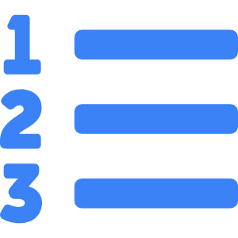


For Loop with Ranges
Controlling Iteration in Steps
Range Function
Generates sequences: range(start, stop, step).
For Syntax
for i in range(n): executes loop n times.
Customization
Supports skipping, reversing, and offsetting.
Typical Uses
Counting, indexing, and batch processing.
Notes:
The `for` loop with `range()` is one of the most common loop patterns in Python. It allows iteration over a sequence of numbers. The range function takes up to three arguments: start, stop, and step. For example, `range(1, 10, 2)` gives you 1, 3, 5, 7, 9.
Using `for i in range(n)` is perfect when you need to perform a fixed number of iterations. You can also use `range()` to loop in reverse by providing a negative step or start from any non-zero index.
This method is ideal for counters, data indexing, or scenarios requiring step-based iteration.

Slide 11

Iterating over Lists and Strings
Handling Collections with Loops
List Iteration: Use for loops to access each item in a list.
String Iteration: Each character in a string is a loopable element.
Index-Free Access: Loop directly over elements without tracking indices.
Versatility: Supports nested structures and any iterable.
Photo by National Cancer Institute on Unsplash
Notes:
Python allows easy iteration over iterable objects like lists and strings. When using `for item in list`, Python retrieves each item one at a time, without needing an index counter.
For strings, each character can be accessed individually in a loop using the same syntax. This makes it simple to analyze or manipulate sequences of characters or values.
This pattern is clean, concise, and Pythonic. It’s also highly versatile—working on tuples, sets, dictionaries (with `.items()`), and more.

Slide 12




While Loop in Practice
Executing Based on Conditions
Structure
Executes block repeatedly while a condition is True.
Flexible Iteration
Good when the number of repetitions isn’t known beforehand.
Risk of Infinite Loops
Always update loop variables to ensure termination.
Typical Uses
Input validation, polling, retrying failed actions.
Notes:
The `while` loop continues executing a block as long as its condition remains true. Unlike `for` loops which are count-based, `while` loops are condition-based—perfect for situations where repetitions are unpredictable.
Example: continue asking the user for a valid password until it's correct. Or keep checking for an event to occur. But be cautious—missing an update to the loop condition can lead to an infinite loop.
Used wisely, `while` loops allow for reactive, event-driven code that adapts in real-time.

Slide 13

Loop Control Statements
break, continue, and pass
break: Exits the loop immediately, skipping remaining iterations.
continue: Skips the current iteration and proceeds to the next.
pass: Placeholder with no action; used to define empty blocks.
Use Wisely: Enhances flow control but overuse may reduce readability.
Photo by Tonik on Unsplash
Notes:
Loop control statements refine how a loop behaves during execution. `break` stops the loop completely and moves to the code after it. This is helpful in early exits—for example, breaking on the first match.
`continue` skips the current iteration and goes to the next, often used when a condition disqualifies certain items from processing.
`pass` is a no-operation placeholder. It allows syntactically correct code where logic will be added later, like empty function bodies or unfinished branches.
Used appropriately, these statements can make your loops more intelligent and purposeful.

Slide 14

Nested Loops
Handling Multi-Dimensional Structures
Definition: A loop inside another loop; useful for grids or matrices.
Common Uses: Iterating through lists of lists, tables, or coordinate systems.
Complexity: Can grow quickly—use with caution to maintain readability.
Optimization: Refactor nested loops using functions or list comprehensions.
Photo by Timothy Dykes on Unsplash
Notes:
Nested loops allow you to perform iteration within iteration. For example, iterating through rows and columns of a matrix, or looping through every item in multiple categories.
They’re commonly used in multidimensional data processing, generating grids, or solving problems with multiple levels of logic like sudoku or chessboards. However, they can increase complexity and slow performance if not managed properly.
Always analyze whether a nested loop is essential or if logic can be simplified. List comprehensions and modular code often provide cleaner alternatives.

Slide 15

Loops in Real-World Data
Practical Applications of Iteration
Batch Processing: Iterate over large data sets for transformation or cleanup.
APIs & Crawlers: Loop through URLs, API endpoints, or web pages.
Monitoring Systems: Use while loops to check sensor data or system logs.
Game Development: Animate frames or loop user events in real-time.
Photo by stem.T4L on Unsplash
Notes:
Loops power real-world systems. In data science, `for` loops are used to batch-process thousands of records—applying transformations, filters, or aggregations. In automation, they trigger events or scan files, logs, or live streams.
`while` loops monitor changing conditions, like watching for system alerts or reading real-time data from sensors. Loops are also essential in game development to update visuals, track input, or refresh the UI at each frame.
These applications show the transition from toy examples to real automation and intelligence driven by loop logic.

Slide 16
Mini Project: ATM Simulation
Combining Conditionals and Loops
Objective: Create an ATM interface with login and transaction options.
Features: Withdraw, check balance, and exit using a loop and menu.
Login Attempt: Limit incorrect PIN entries using while and if.
Wrap Logic: Use loop to keep user in session until exit is chosen.
Photo by ar java on Unsplash
Notes:
This hands-on mini project simulates an ATM machine. Users can 'log in' with a PIN, then choose actions like checking their balance, withdrawing funds, or exiting. We’ll use `while` loops for session control and `if` conditions for menu handling.
It starts with a login validation—limiting failed attempts. Once authenticated, a loop presents options. Each selection is handled with conditionals. The project introduces real-life logic, data storage (like a balance variable), and flow control.
By the end, students will experience how foundational logic transforms into a functioning user interaction model.

Slide 17

ATM Simulation: Implementation Steps
Code Flow and User Journey
Step 1: Login: Prompt for PIN and validate (max 3 attempts).
Step 2: Menu: Display choices: Check Balance, Withdraw, Exit.
Step 3: Logic: Use if-elif to handle selected options.
Step 4: Loop: Repeat until user exits using a while loop.
Photo by Blake Connally on Unsplash
Notes:
To implement the ATM simulation, we start with a secure login loop. Ask the user to enter a PIN and validate it, allowing only three attempts.
Once validated, present a simple menu in a loop. Use input to let users choose between checking their balance, withdrawing funds, or exiting. Handle these choices using `if-elif-else` conditions.
The session continues until the user selects 'Exit'. This demonstrates real control flow in action, handling user input and conditions within a loop context.

Slide 18
ATM Simulation: Code Review
Sample Output and Discussion
Authentication: Show sample code for validating PIN.
Main Loop: Loop with menu display and input handling.
Withdraw Logic: Example condition checking balance before deduction.
Exit Case: Use break to exit the menu and close session.
Photo by Nate Grant on Unsplash
Notes:
Let’s walk through a sample implementation of the ATM simulation. First, the PIN validation block uses a `while` loop with a counter. If the correct PIN is entered, the user proceeds; otherwise, access is denied after 3 attempts.
Inside the main loop, a menu is displayed repeatedly. Based on the input, `if` statements determine whether to show the balance, handle a withdrawal (checking if funds are sufficient), or exit the session.
This complete structure demonstrates how loops and conditionals come together in real applications. It's interactive, responsive, and logically segmented for clarity.

Slide 19
Peer Review Task
Evaluate Code Logic and Clarity
Review Guidelines: Check for structure, readability, and correctness.
Discussion: Identify strengths and improvement areas in peer code.
Bug Spotting: Find and suggest fixes for logic or flow errors.
Team Growth: Fosters collaboration and learning from others’ perspectives.
Photo by ar java on Unsplash
Notes:
A peer review is one of the best ways to improve code quality. Review a partner’s ATM simulation implementation or a sample given in class. Look for correct structure, proper use of loops and conditionals, and overall clarity.
Discuss what’s working and what could be improved. Are there redundant blocks? Could the code be cleaner or more efficient?
This practice sharpens your eye for detail, improves your own coding habits, and encourages teamwork. Software development is collaborative—getting used to code reviews early sets the stage for real-world success.

Slide 20

Summary and Homework
Wrap-Up of Day 2: Control Statements
Key Concepts: Mastered if-else, loops, nested logic, and control statements.
Mini Project: Completed ATM simulation using all core topics.
Peer Review: Practiced collaborative debugging and quality checks.
Homework: Create a calculator with looping menu and error handling.
Photo by Kaleidico on Unsplash
Notes:
Today we explored Python control statements in depth—conditionals, loops, and logical constructs that bring your programs to life. You built an ATM simulator, practiced real-world decision logic, and engaged in peer review.
Homework for tonight: Build a calculator that supports addition, subtraction, multiplication, and division. It should run until the user chooses to exit, and handle input errors gracefully.
Tomorrow we’ll expand into data structures, beginning with lists, tuples, and dictionaries. Review today’s material and be ready to use it in more complex contexts.

